Slide 1
Baltimore Crime Data and Gun Offenders Registry
By Chloe Schnydman

Slide 2
Data Sources
Both found on Open Baltimore
Part 1 Crime Data: link
Represents the location and characteristics of part 1 of the major crime against persons within the City of Baltimore
1960s~ to December 2024
644,737 rows
Gun Offenders Registry: link
for persons convicted of at least one gun-related offense and are required to register their name and dress with police
March 2024 to January 2025
3,739 rows

Slide 3
Data Retrieval
Had to clean both datasets the same way
Dropped unused columns
Missing values were converted to “NA”
Dropped Latitude/Longitude and Neighborhoods that were “NA”
Dropped Latitude/Longitude that were 0
Converted all categorical variables to factor types

Slide 4
Exploratory Data Analysis

Slide 5
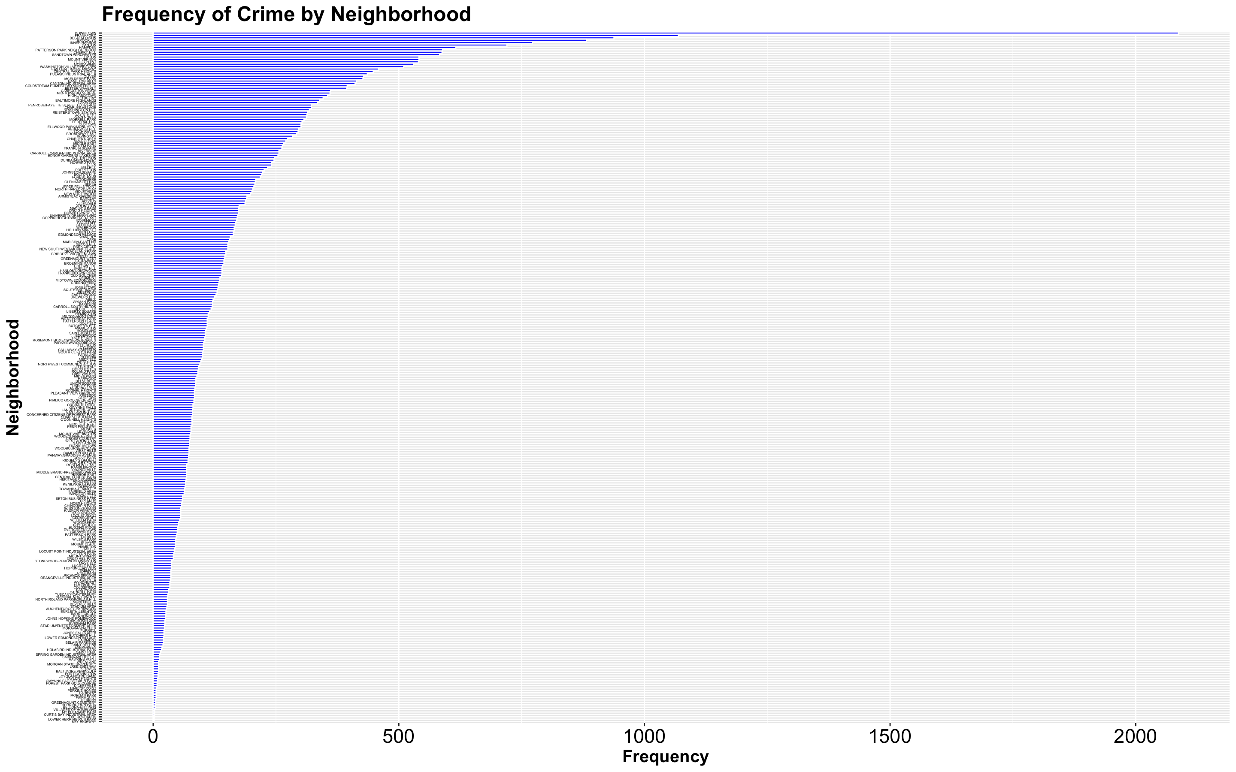

Slide 6
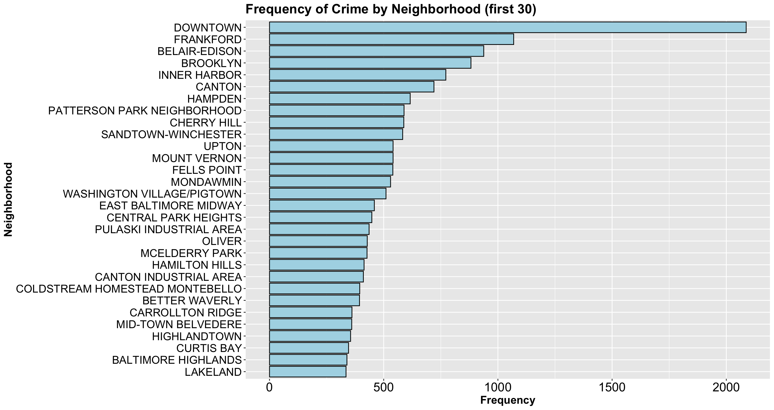


Slide 8
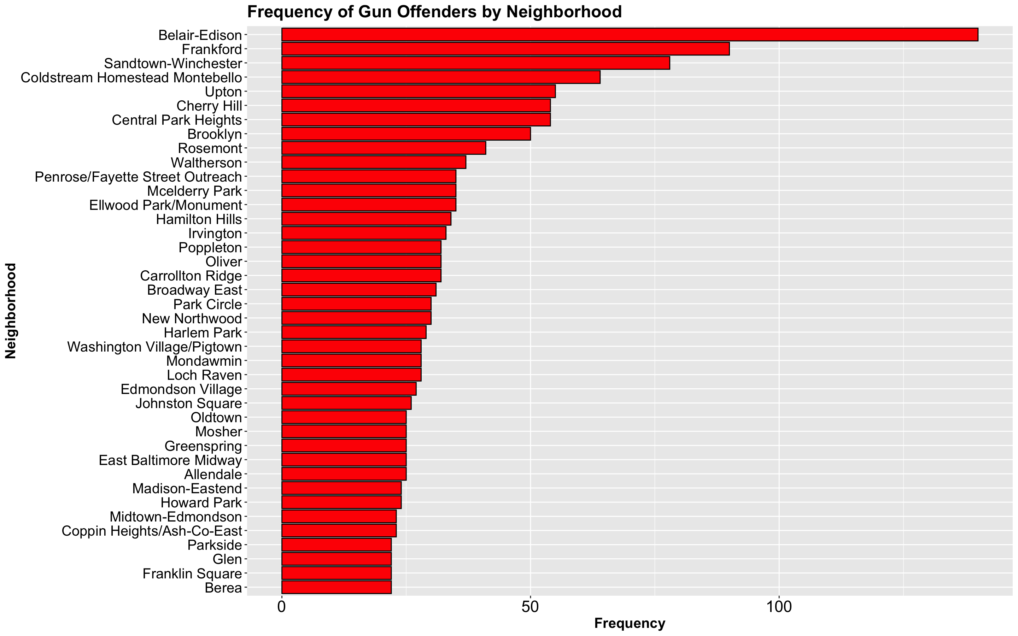
(first 40)

Slide 9
(first 40)

Slide 10
(first 40)
Top 10 Neighborhoods in each Dataset

Slide 11
(first 40)
Top 10 Neighborhoods in each Dataset

Slide 12



Frankford
Belair-Edison
Sandtown-Winchester

Slide 13
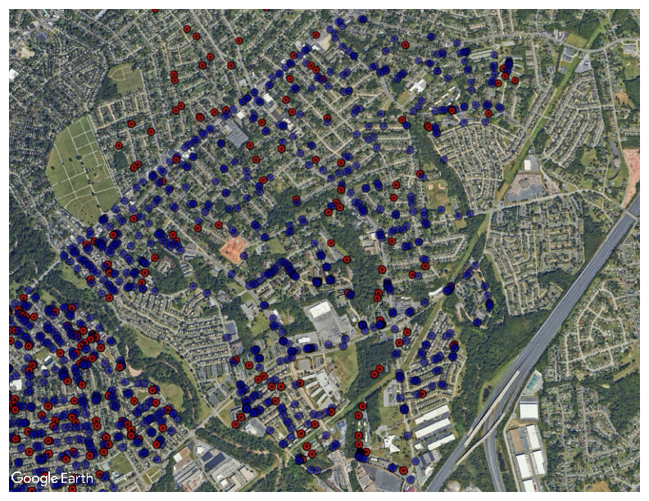
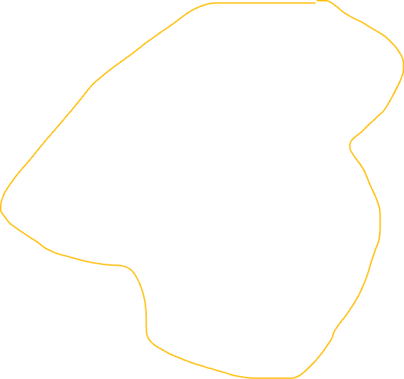
Frankford

Slide 14
Implications for Stakeholders
This project will affect the people living in Baltimore, but more specifically, living in the neighborhoods of the arrests and/or the gun offenders.
They will be able to see when crime is at a high in their part of the city and will see if there is a connection between the crime rates and gun offenders' homes.
Not only will civilians be affected by this data but the police departments all over Baltimore City. They will be able to visualize crime that occurs in their district

Slide 15
Ethical, Legal, Societal Implications
The ethical complications that I will be running into are racial and gender biases. Given how diverse and stereotyped Baltimore City is, there are high chances of biased arrests based on gender, race, ethnicity, or age

